Slide 1
EHS AP Exam Registration and Payment Process
2023-24

Slide 2
The Possibilities
30 Courses
2,849* Current enrollments in AP courses
*8/22/23
Based on previous year 2,164 possible exams

Slide 3
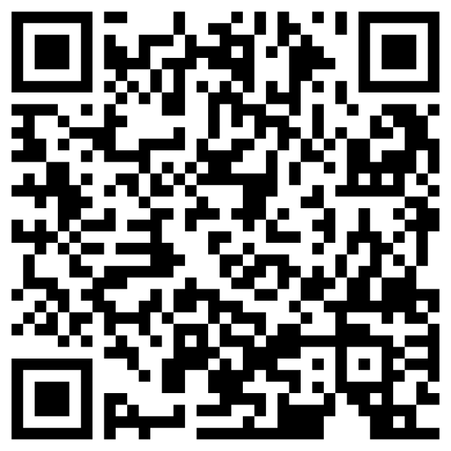
Tips for AP Course Success
Use AP Classroom
Access AP resources, practice materials and personal progress dashboard
Watch AP Daily Videos
Available live or on demand
Search College Credit Policies
AP Credit Policy search tool
Specific policies for credit
Connect with Colleges
Student Search Services connects you directly with schools that match your interest
29% more offers for college admissions
$300 million in scholarships

Slide 4
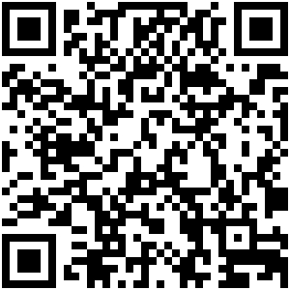
AP Classroom
Students must have a College Board account
https://myap.collegeboard.org/login
Most students already have this account since FBISD gives the PSAT beginning in middle school
The student must contact College Board directly if they do not remember their account information – DO NOT CREATE A SECOND ACCOUNT
888-225-5427
Account Help
https://support.collegeboard.org/help-center/account-help

Slide 5
Dates and Deadlines
Date | Descptition
Aug. 10 - Sept 15, 2023 | All students in Year Long and Fall courses expected to enroll in AP Classroom and Join EHS Counselors and College & Career Readiness Schoology Group
Sept. 1, 2023 | Revtrak opens for payments
Oct. 11, 2023 | All students should have made an AP exam Decision in AP Classroom
Oct 31, 2023 | Last day to make an exam decision AND payment for Full Year and Fall Courses
 | If no payment has been made the exam will not be ordered, if payment is made and student is not in CB then no exam will be ordered
Nov. 2 - Jan. 3, 2024 | No Revtrak/AP Classroom adjustments will be made
Jan. 3 - Feb. 15 | Students enroll in Spring AP Classroom courses, make exam decisions and join EHS Counselors and College & Career Readiness Schoology Group
 | Late registration and payment accepted for Fall and Full Year courses
Jan. 18, 2024 | Last day to submit College Board Consent Form for Accommodations Request
Feb. 24, 2024 | Last day for all registration and payment for all exams and exam changes

Slide 6
Registration – Fall and Year Long Courses
Obtain Join Code from each AP teacher – teacher and period specific
Students log into myap.collegeboard.org
Enter Join Code
Update profile information
Verify spelling of name and birthdate
Use personal email, one you check
School code 446782
FBISD Student ID needs to be correct, no leading zero
Student MUST make exam decision
September 15th – teachers will verify enrollment
October 11th - teachers will verify exam decision
October 31st - final date students can make an exam decision and make payment

Slide 7
Payment
$98 per exam
$146 for Research and Seminar courses
$54* per exam for Free-Reduced – TEA may provide supplement TBD
$102* for Research and Seminar for Free-Reduced – TEA may provide supplement TBD
Payment will be accepted only through this RevTrak! link
Deadline for payment is October 31st
Click here to apply for Free/Reduced Lunch program
https://www.schoolcafe.com/fbisd

Slide 8
Payment Installment Option
Students can request an AP Payment Installment Plan
Click AP Payment Plan Request to complete one form per exam
Option 1 – 2 Payments
October 31st, 2023- Initial
February 24, 2024 - Final
Option 2 – 4 Payments
October 31st, 2023- Initial
December 1, 2023 - Second
January 15, 2024 - Third
February 24, 2024 -Final
Installment plan not available for late orders
At least one installment must be submitted by October 31, 2023 for an exam to be ordered
You will receive a separate RevTrak link to submit your installment payments

Slide 9
Cancelation/Late Registration & Payment
November 2nd: exams that have not been paid will be removed from the order
November 1 – January 3 Join Codes will be expired for Fall and Year Long courses.
January 4-February 24 - If you did not join by the deadline, you must see your counselor to receive a join code and payment link and students may order and pay with $40 late fee CB applied

Slide 10
One Semester Courses
Fall Courses
United States Government & Politics
Macroeconomics
Psychology (Semester 1)
AP Human Geography (Semester 1)
Physics C: Mechanics
Deadline for registration and payment October 31, 2023
Spring Courses
United States Government & Politics
Macroeconomics
Psychology (Semester 2)
AP Human Geography (Semester 2)
Physics C: Electricity & Magnetism
Registration will open when classes start in January, same process
Deadline for registration and payment is February 24, 2024

Slide 11
SPECIAL NOTE
After February 24, 2024, there will be NO exam changes and students will not be eligible for any refund
Have your student join the EHS Counselors and College & Career Readiness Schoology Group to reference the AP Folder
Click on Course (In Schoology)
Click on My Course (upper right-hand corner)
Click on Join Course or a + sign
Enter Access Code
7NPB-W4H5-RVN29

Slide 12
Exam Dates
Week 1 | Morning 8 a.m. | Afternoon 12 p.m.
 | Local Time | Local Time
 | United States Government and Politics | Art History
Monday, May 6, 2024
 |  | Chemistry
 | Human Geography | Seminar
Tuesday, May 7, 2024
 |  | Statistics
 | English Literature and Composition Seniors
Wednesday, May 8, 2024
 |  | Computer Science A
 | Chinese Language and Culture | Psychology
Thursday, May 9, 2024
 | Environmental Science
 | European History | Macroeconomics
Friday, May 10, 2024
 | United States History - Juniors | Spanish Literature and Culture -5
Art and Design: Friday, May 10, 2024 (8 p.m. ET), is the deadline for AP Art and Design students to submit their three portfolio components as final in the AP Digital Portfolio.
Saturday, January 0, 1900P | Morning 8 a.m. | Afternoon 12 p.m. | Afternoon 2 p.m.
 | Local Time | Local Time | Local Time
 | Calculus AB
Monday, May 13, 2024
 | Calculus BC | Precalculus
 | English Language and Composition Juniors | African American Studies | Physics C: Electricity and Magnetism
Tuesday, May 14, 2024
 |  | Physics C: Mechanics
 | French Language and Culture | Computer Science Principles
Wednesday, May 15, 2024
 | World History: Modern- Sophomores
 | Spanish Language and Culture – 4 | Biology
Thursday, May 16, 2024
Friday, May 17, 2024 |  | Physics 2: Algebra Based
 | Physics 1: Algebra-Based

Slide 13
Final Thoughts
Deadline to order or pay for any AP exam is February 24, 2024
$40 CB late fee applied to Fall and Full Year exams ordered after October 31, 2023
$40 CB cancelation fee applied to exam canceled after October 31, 2023, for Fall and Year Long courses
No exam order changes or cancelations accepted after February 24, 2024
Remember, students who take AP course and the exams are more likely to be successful in college
Communication will come through classroom teachers, EHS Website/Counselor Webpage and EHS AP Counselors and College & Career Readiness Schoology Group-AP Folder,– please check your emails
If you student receives testing accommodations through Section 504 or Special Education, please email completed CB Accommodation form to
Mrs. Wolf @ Richerica.Wolf@fortbendisd.com

